Slide 1
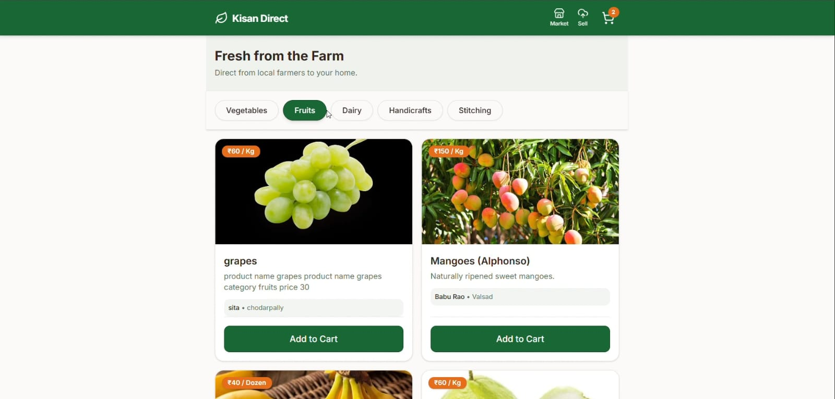
KISAN DIRECT
Application for Direct Sale
of Products by Farmers

Slide 2
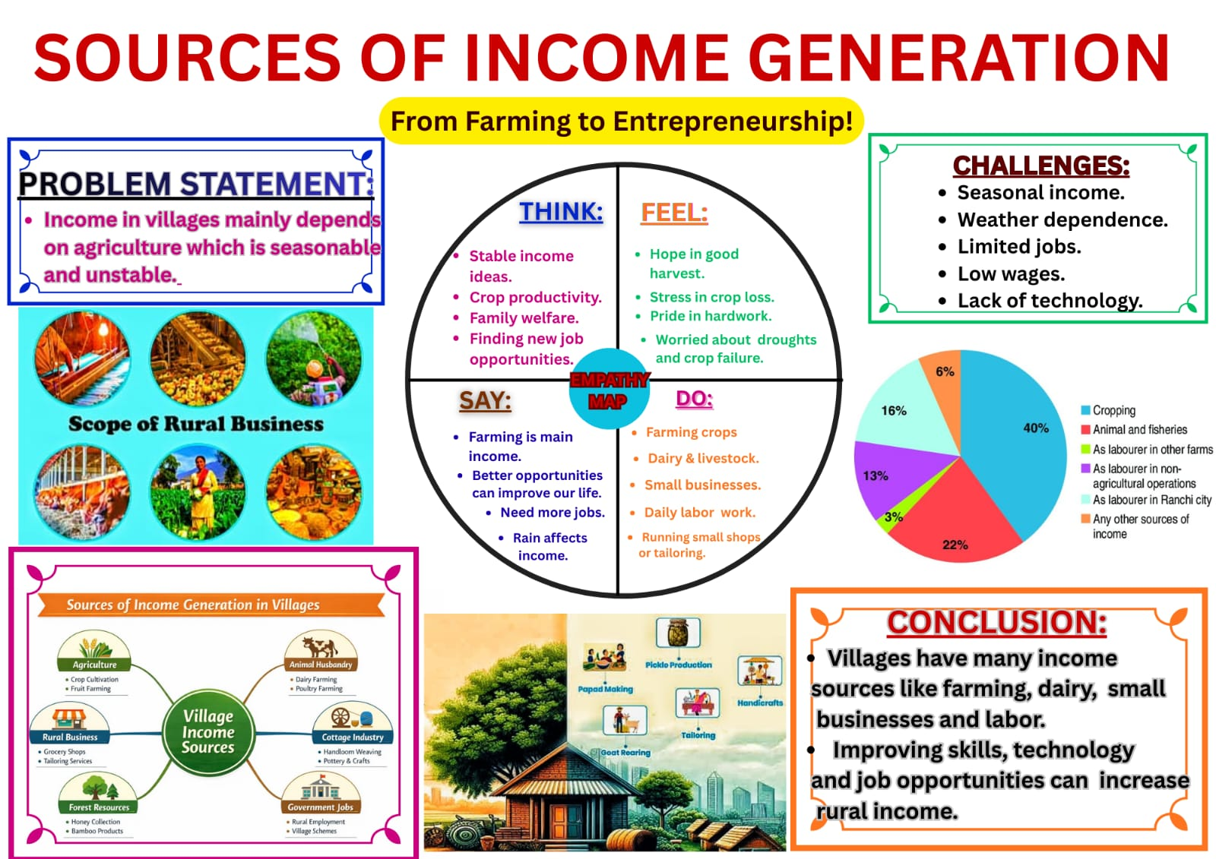
Problem
02
Middlemen
Lower Earnings
Farmers depend on intermediaries, reducing direct customer interaction.
Middlemen can reduce the share earned by farmers.
Difficult Selling
Rural Usability
Farmers need a simple way to list products digitally.
The platform must be simple, clear and mobile-friendly.
Need: Direct • Simple • Mobile-friendly

Slide 3
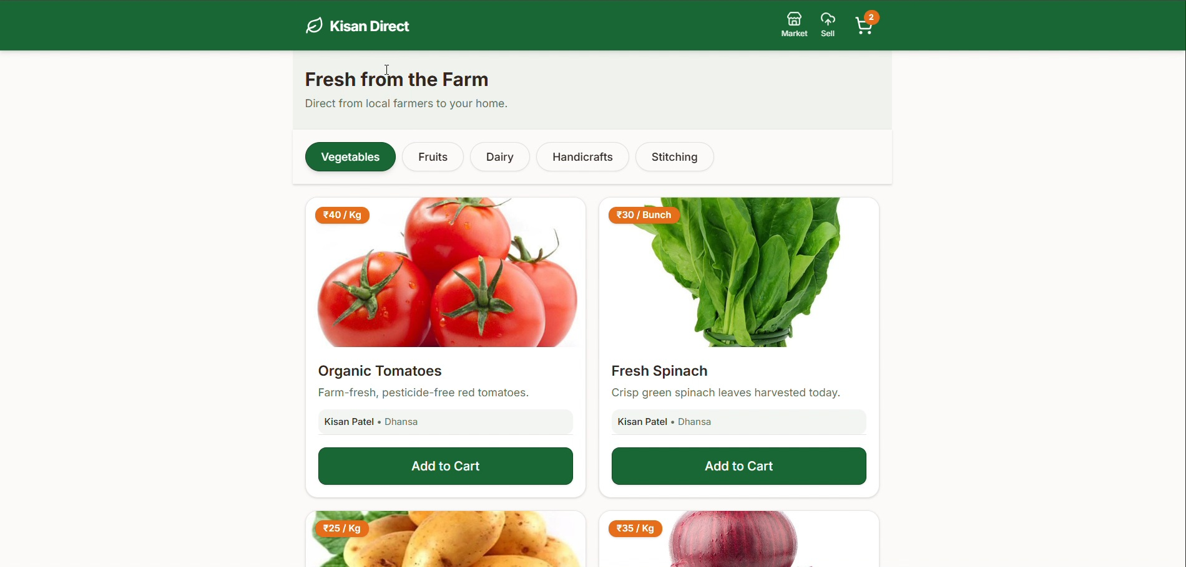
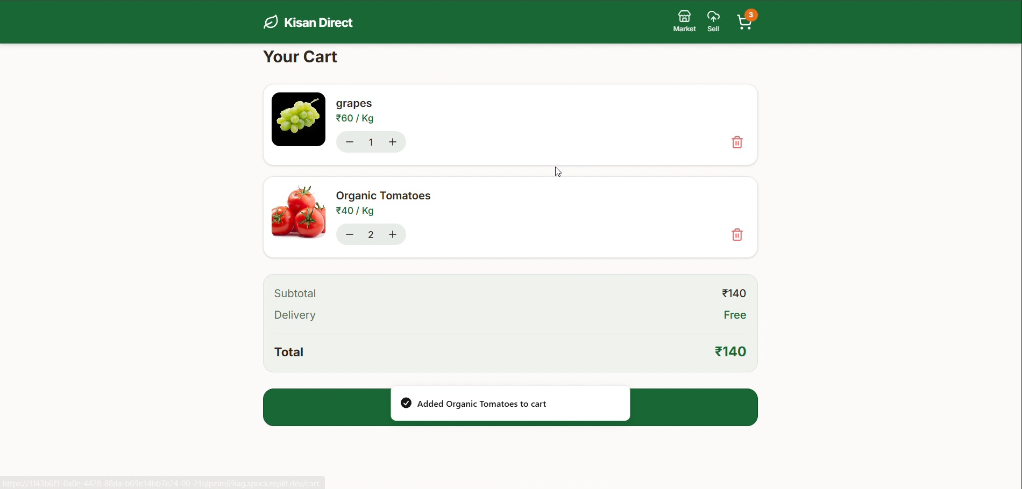
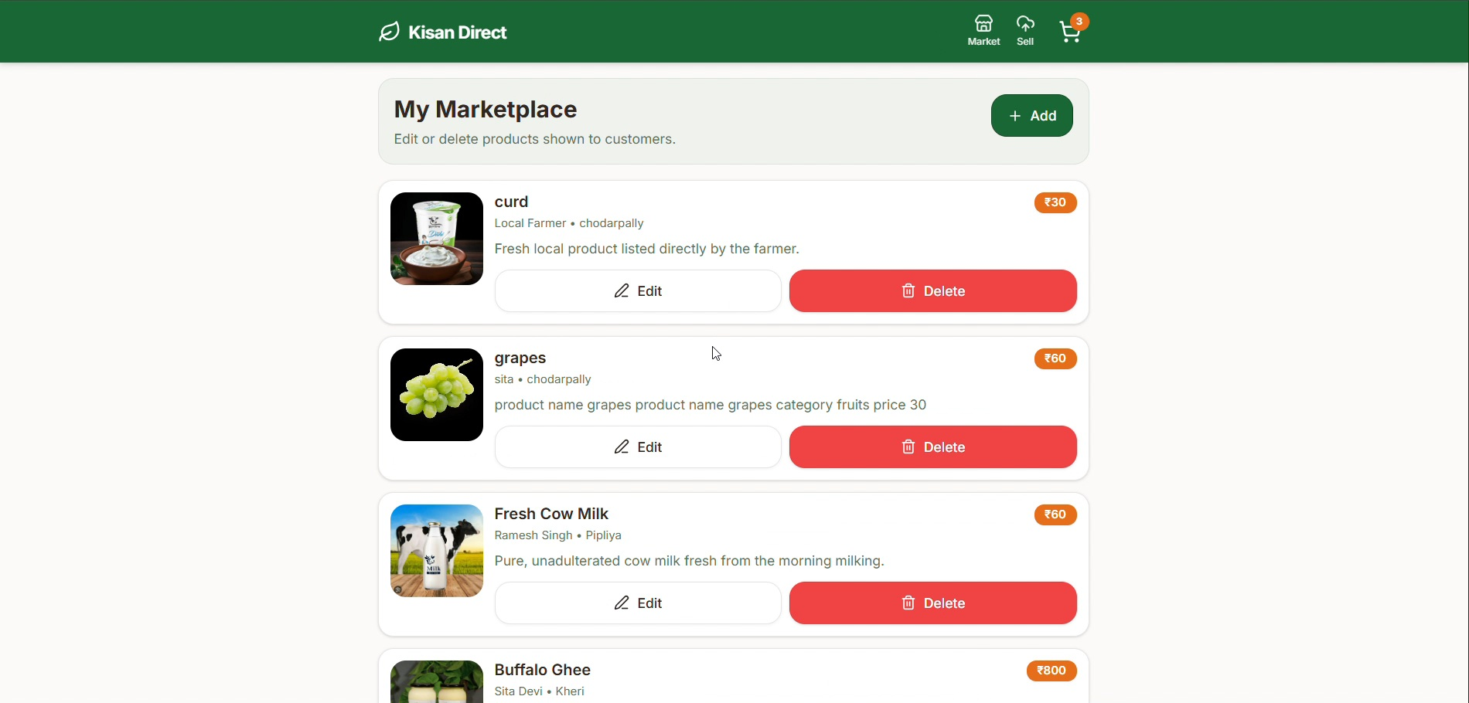
Solution
03
A direct farmer-to-customer marketplace
1 List Products
Images, prices and descriptions.
2 Voice Upload
Microphone feature for easier product entry.
3 Sell Directly
Customers browse and buy without middlemen.

Slide 4
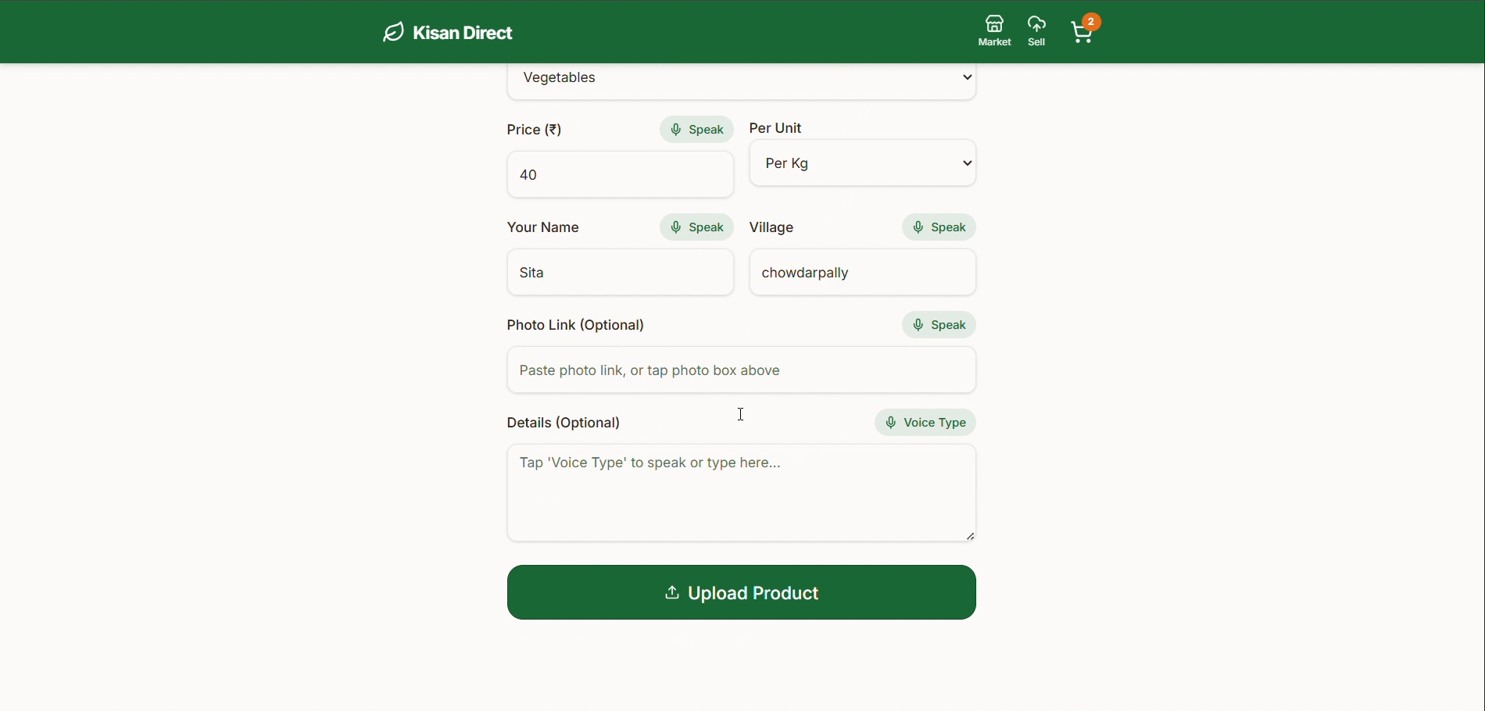
How It Works
04
01
→
02
→
03
→
04
→
05
Farmer
Browse
Cart
Order
Pay
Adds product
Customer selects items
Adds products
Confirms purchase
COD / UPI

Slide 5
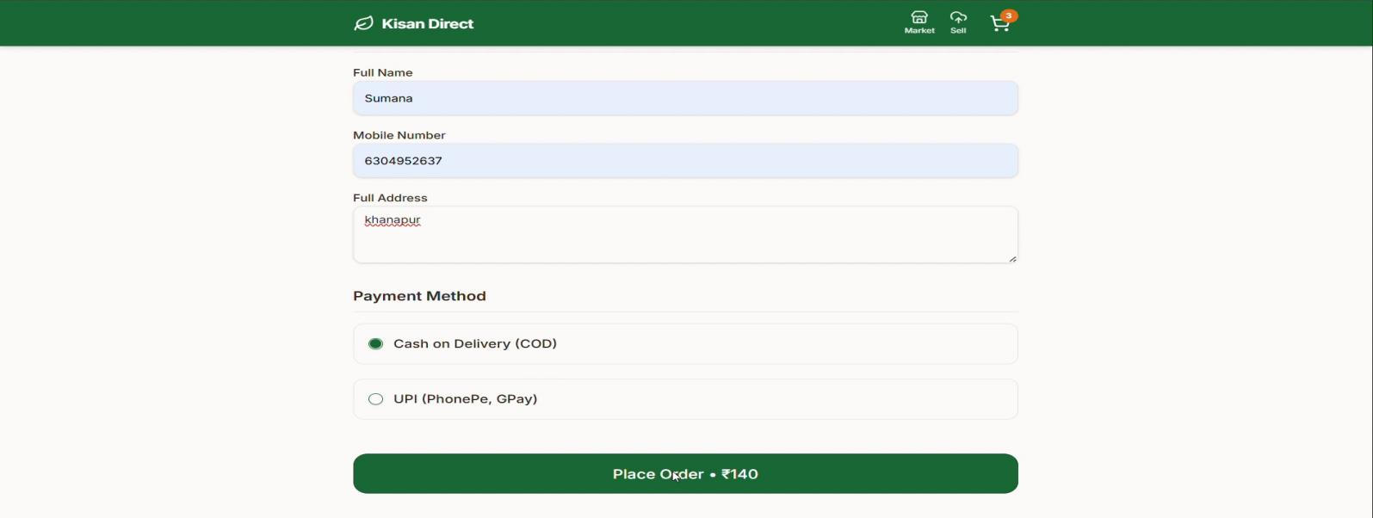
Technologies
05
Replit
Voice / Microphone
Prototype developed as a simple website using Replit.
Voice-based product upload for easier entry.
Mobile Web UI
Payments
Simple, visual and mobile-friendly interface.
Cash on Delivery (COD) and UPI.
Technology used in the prototype

Slide 6
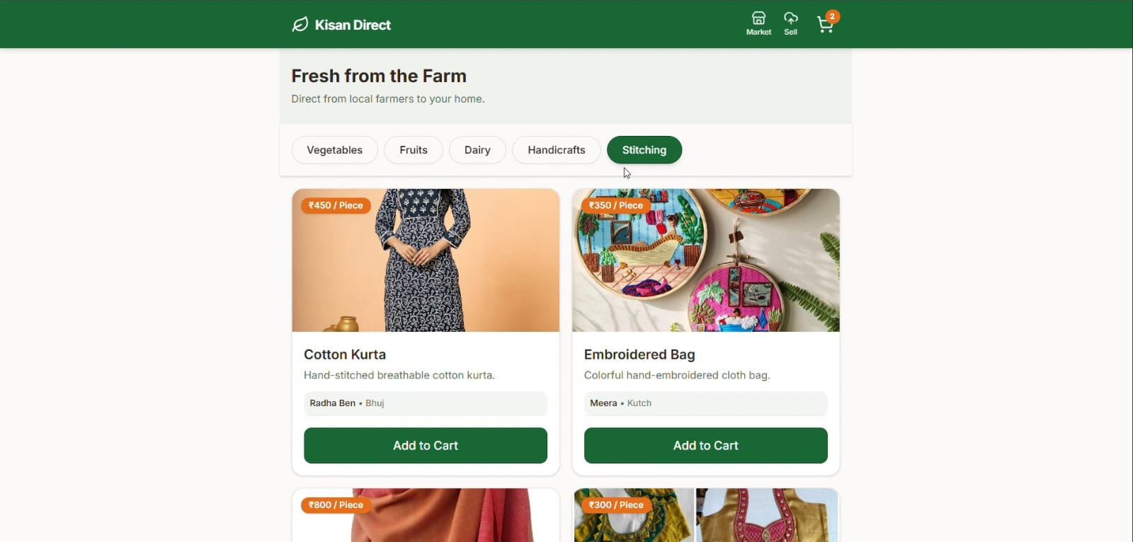
Benefits
06
For Farmers
For Customers
Direct access to customers
Easy browsing and ordering
Easy Access
Convenient Selling
Mobile-friendly and simple UI
Voice upload + cart + payments

Slide 7
Future Scope
07
More product categories
Multiple language support
Farmer & customer login
Delivery tracking
More payment options
Chat, ratings & reviews
Mobile application
Advanced search & filters
Kisan Direct

